Slide 1


Introduction to 8085 Microprocessor
Presented by
Mahbubur Rahman
Lecturer
Department of Computer Science and Engineering(CSE)
Green University of Bangladesh(GUB)

Slide 2
8085 Microprocessor Architecture

Slide 3
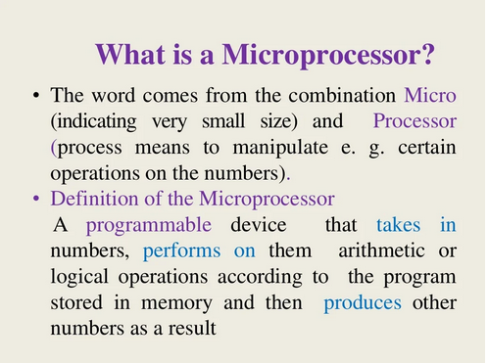

Slide 4
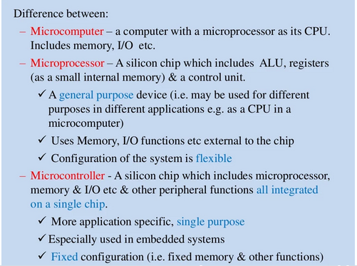

Slide 5
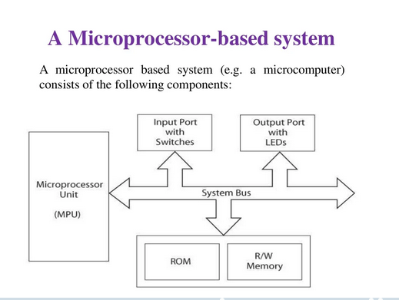

Slide 6
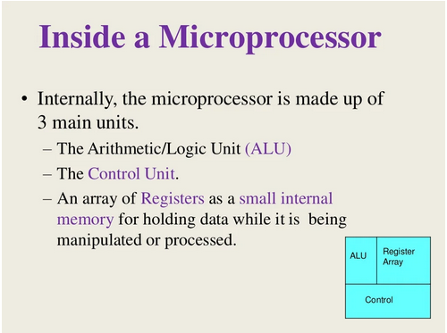

Slide 7
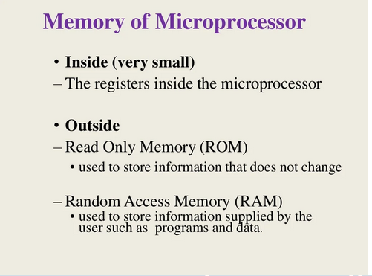

Slide 8
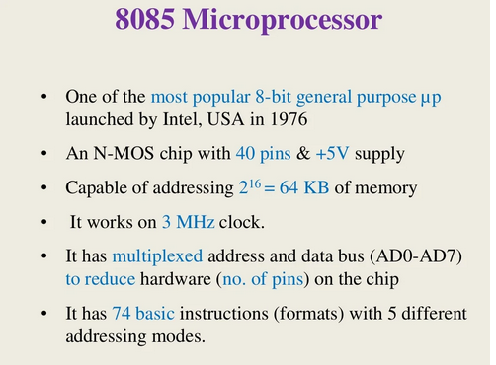

Slide 9
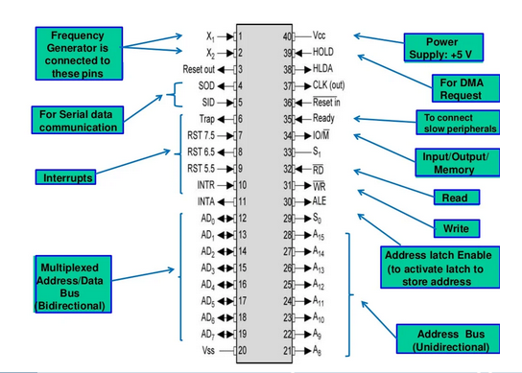

Slide 10
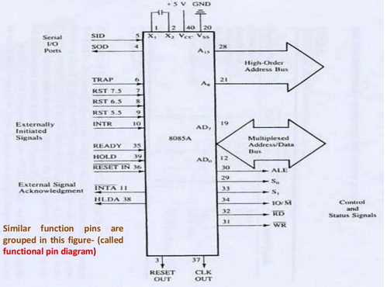

Slide 11
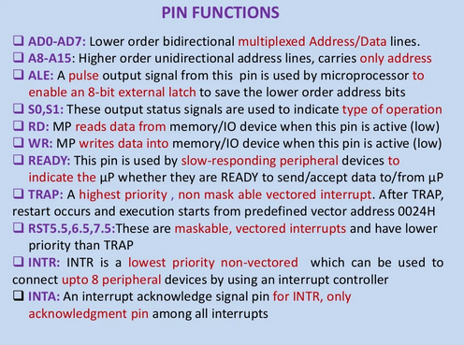

Slide 12
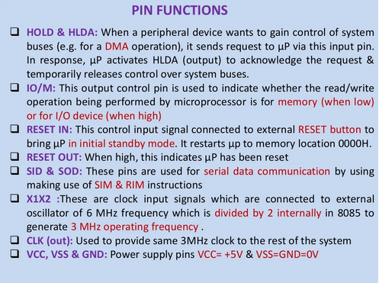

Slide 13
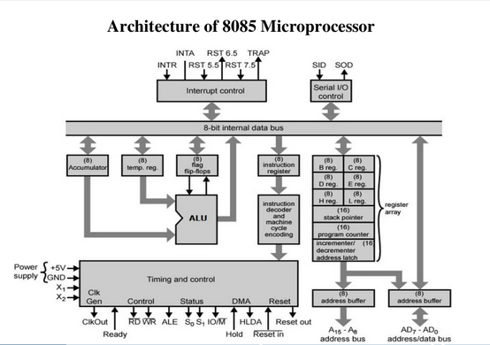

Slide 14
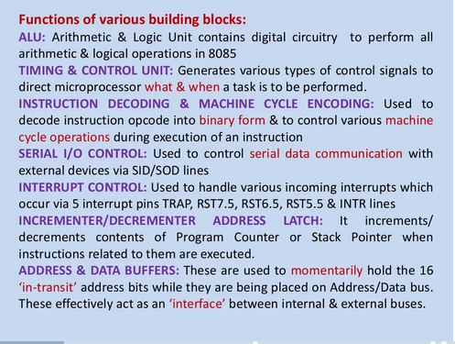

Slide 15
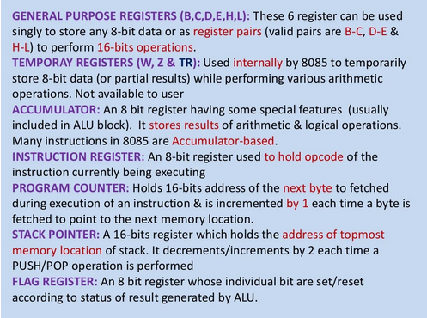

Slide 16
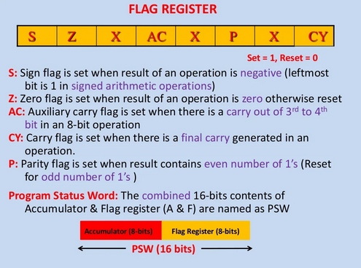

Slide 17
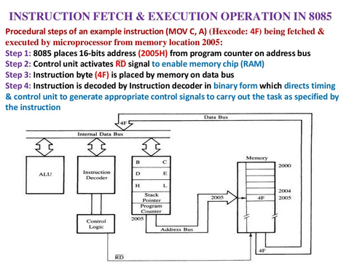

Slide 18
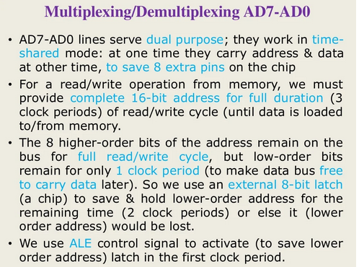

Slide 19
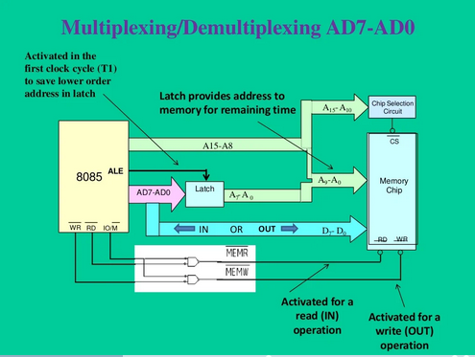

Slide 20
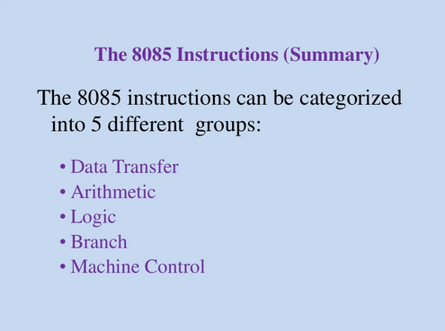

Slide 21
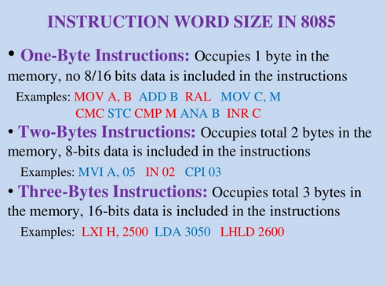

Slide 22
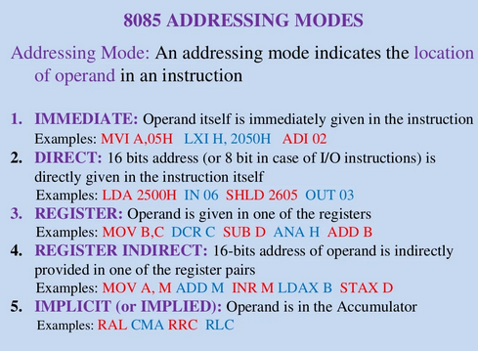

Slide 23
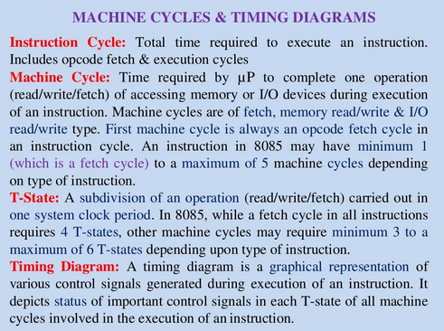

Slide 24
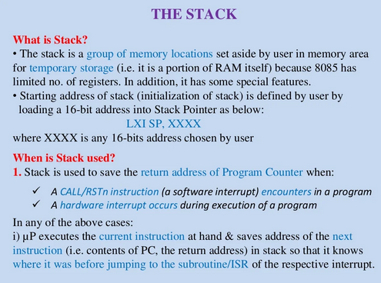

Slide 25
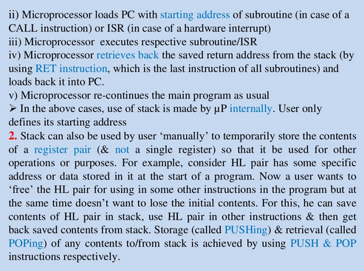

Slide 26
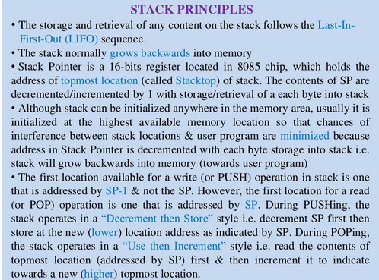

Slide 27
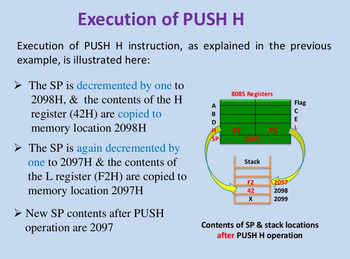

Slide 28
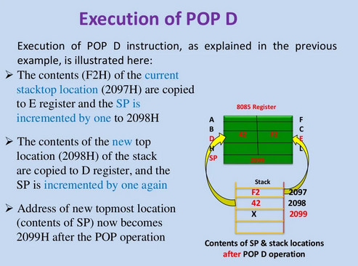

Slide 29
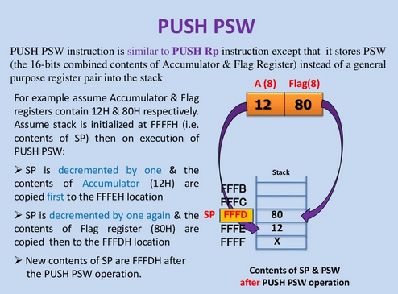

Slide 30
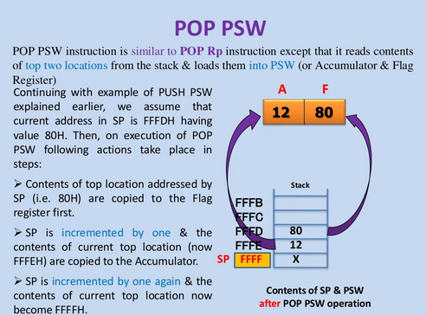

Slide 31
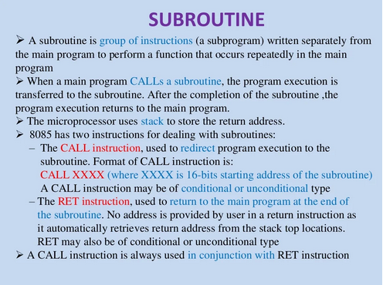

Slide 32
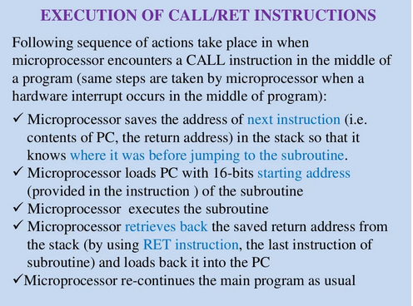

Slide 33
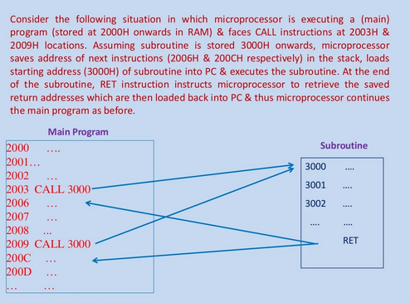

Slide 34
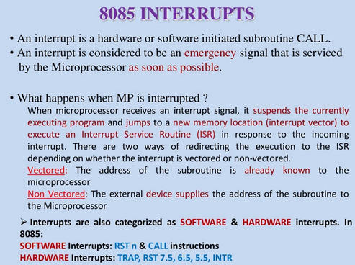

Slide 35
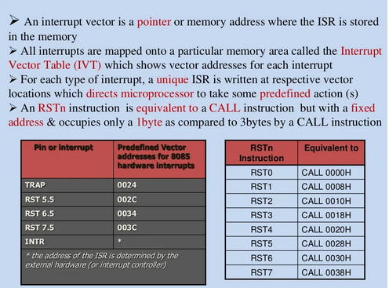

Slide 36
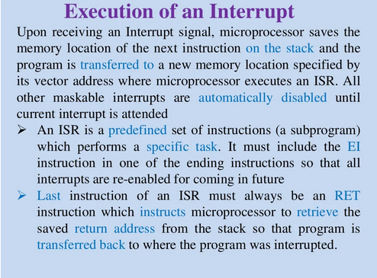

Slide 37
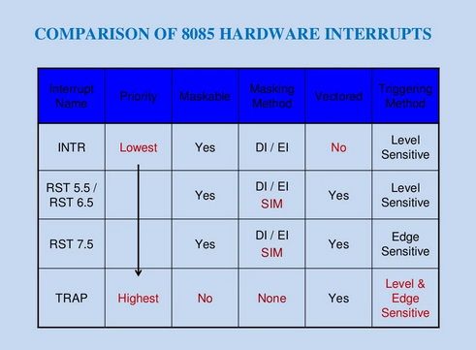

Slide 38
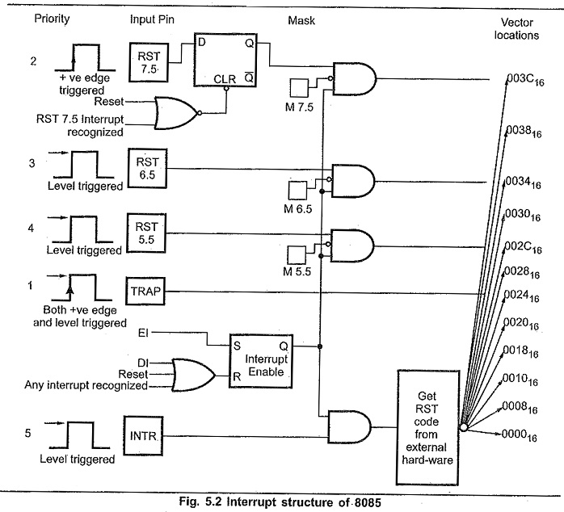

Slide 39
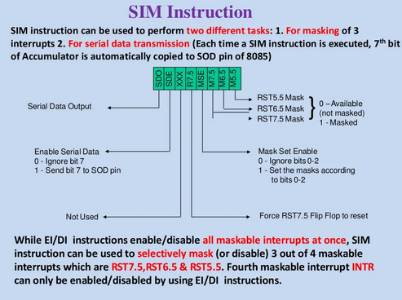

Slide 40
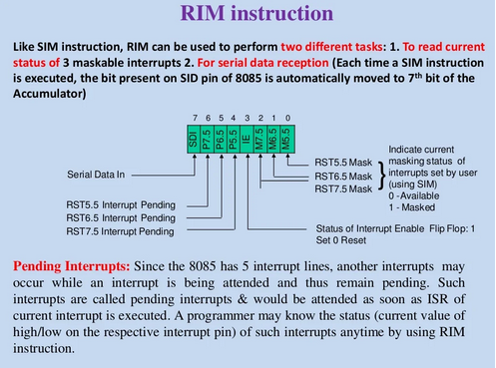

Slide 41
Features | Memory Mapped IO | IO Mapped IO
Addressing | IO devices are accessed like any other memory location. | They cannot be accessed like any other memory location.
Address Size | They are assigned with 16-bit address values. | They are assigned with 8-bit address values.
Instructions Used | The instruction used are LDA and STA, etc. | The instruction used are IN and OUT.
Cycles | Cycles involved during operation are Memory Read, Memory Write. | Cycles involved during operation are IO read and IO writes in the case of IO Mapped IO.
Registers Communicating | Any register can communicate with the IO device in case of Memory Mapped IO. | Only Accumulator can communicate with IO devices in case of IO Mapped IO.

Slide 42
Features | Memory Mapped IO | IO Mapped IO
Space Involved | 2¹⁶ IO ports are possible to be used for interfacing in case of Memory Mapped IO. | Only 256 I/O ports are available for interfacing in case of IO Mapped IO.
IO/M` signal | During writing or read cycles (IO/M` = 0 ) in case of Memory Mapped IO. | During writing or read cycles (IO/M` = 1) in case of IO Mapped IO.
Control Signal | No separate control signal required since we have unified memory space in the case of Memory Mapped IO. | Special control signals are used in the case of IO Mapped IO.
Arithmetic and Logical operations | Arithmetic and logical operations are performed directly on the data in the case of Memory Mapped IO. | Arithmetic and logical operations cannot be performed directly on the data in the case of IO Mapped IO.

Slide 43
Basis for Comparison | Memory mapped I/O | I/O mapped I/O
Basic | I/O devices are treated as memory. | I/O devices are treated as I/O devices.
Allotted address size | 16-bit (A₀ – A₁₅) | 8-bit (A₀ – A₇)
Data transfer instructions | Same for memory and I/O devices. | Different for memory and I/O devices.
Cycles involved | Memory read and memory write | I/O read and I/O write
Interfacing of I/O ports | Large (around 64K) | Comparatively small (around 256)
Control signal | No separate control signal is needed for I/O devices. | Special control signals are used for I/O devices.
Efficiency | Less | Comparatively more
Decoder hardware | More decoder hardware required. | Less decoder hardware required.

Slide 44
Basis for Comparison | Memory mapped I/O | I/O mapped I/O
IO/M’ | During memory read or memory write operations, IO/M’ is kept low. | During I/O read and I/O write operation, IO/M’ is kept high.
Data movement | Between registers and ports. | Between accumulator and ports.
Logical approach | Simple | Complex
Usability | In small systems where memory requirement is less. | In systems that need large memory space.
Speed of operation | Slow | Comparatively fast
Example of instruction | LDA ****H STA ****H MOV A, M | IN ****H OUT ****H

